Slide 1
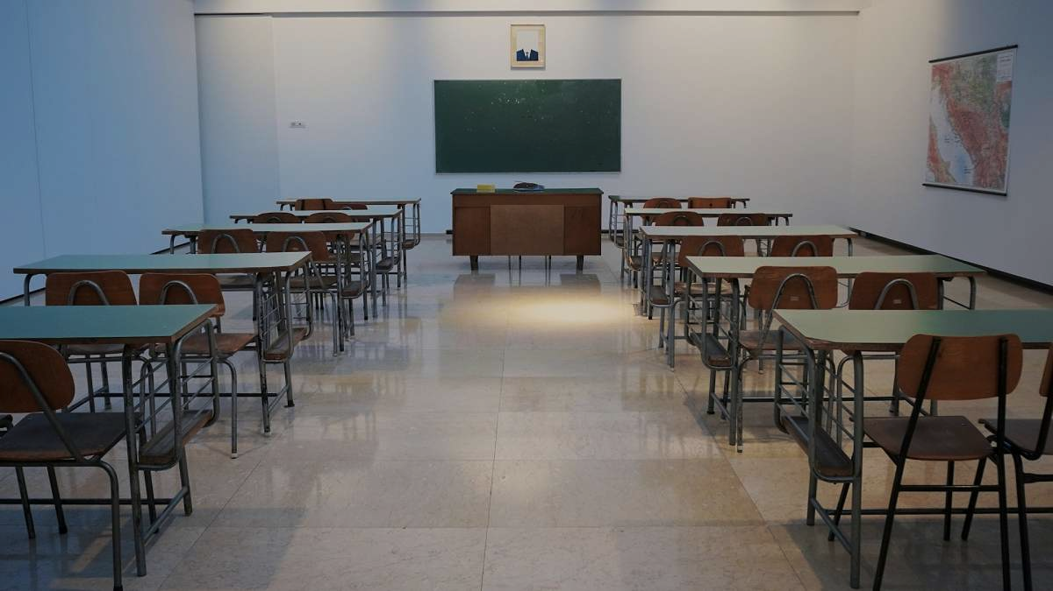

FAITHFULNESS TO ADVENTIST EDUCATION PRINCIPLES
EDUCATION HOUR
DEUT. 6:4-7

Slide 2

Introduction
One of the greatest dangers of our fast modern lifestyle in the 21st century world is that we become so occupied with incidentals, non-essentials and minors that we neglect the fundamentals, the essentials and the majors.

Slide 3
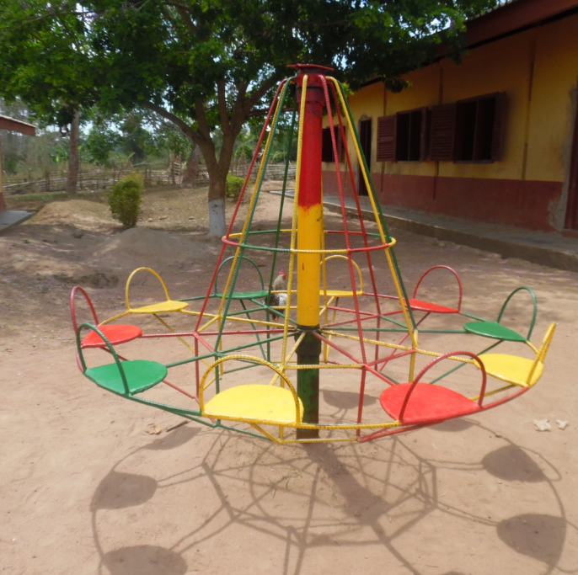
We ride the merry-go-round whirling a hundred times which is equivalent to travelling three miles, but we get nowhere.
We take a ride for the ride’s sake.
Notes:
In reality, we are taken for a ride.

Slide 4

For billions of people life is one continuous merry-go-round.
Going but never arriving; moving but getting nowhere

Slide 5

We can be so pre-occupied with the incidentals of life, the mediocre, the mundane that we allow the essentials to slip away.

Slide 6
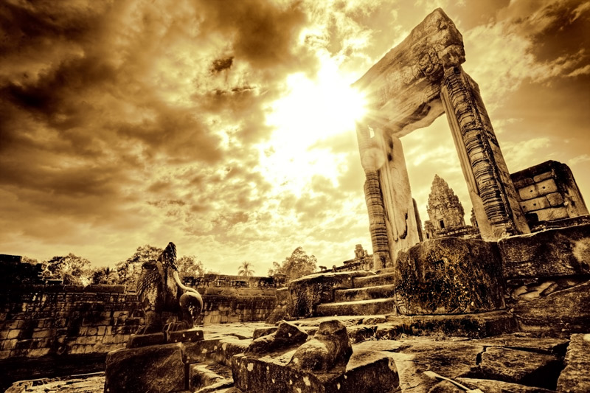
COME OUT OF HER

Slide 7
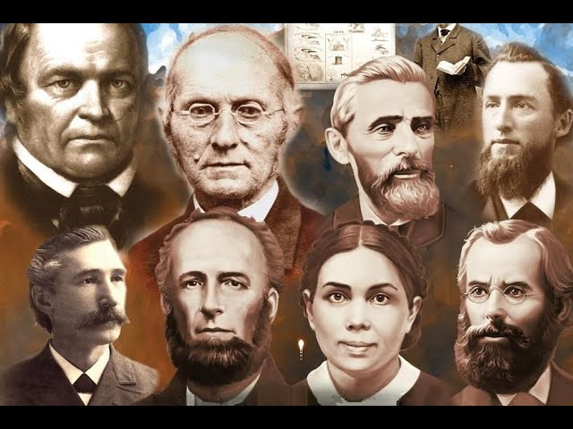
It seems that we have forgotten the serious warning given to the Seventh-day Adventist pioneers during the late 1800s that we should take our children out of the state schools and teach them at home or set up church schools

Slide 8
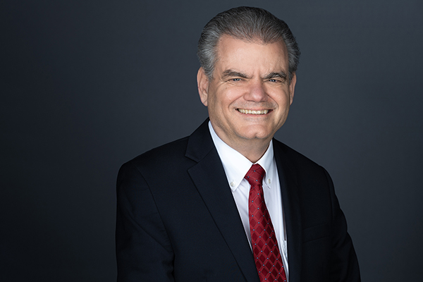
‘Come out of her my people.’ Shall we come out of Babylon and leave our children behind?’
(John Wesley Taylor V, Adventist Education, Origins of)

Slide 9

You see the world was groaning into the final stages of earth’s history and God wanted His people to get ready, to be prepared for His Son’s Second Coming and to ensure that their children were also prepared and educated to meet the Lord.
Notes:
Time was speeding away and it was imperative that God saved His little ones.

Slide 10
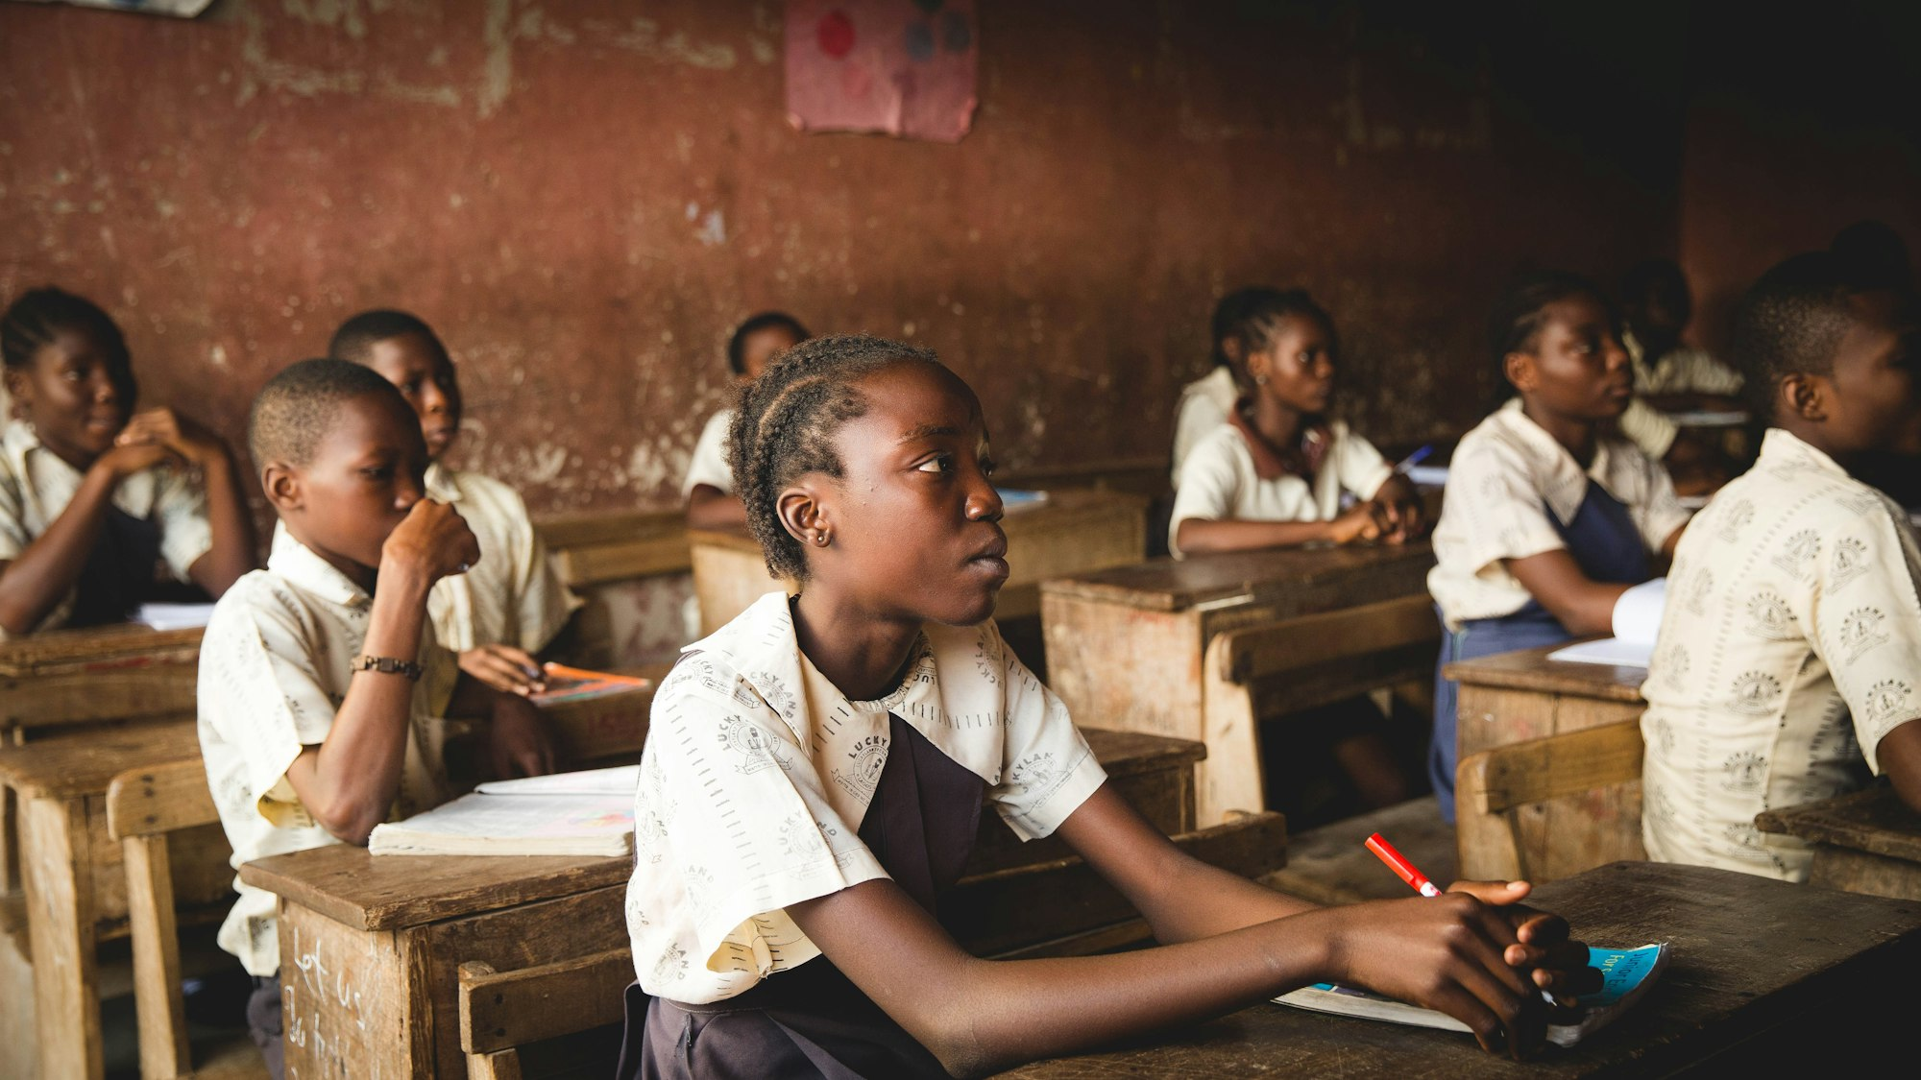
Colonial Schools

Slide 11
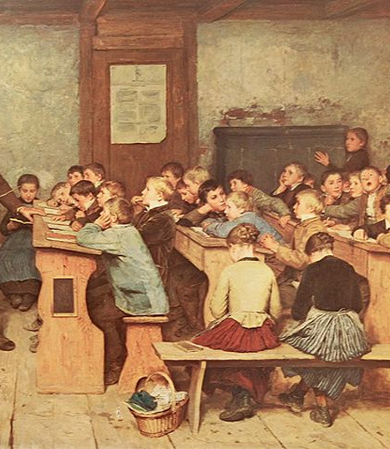
Schools during the late 19th Century and Early 20th Century were not places to educate and mould children for heaven.
Instead, they were places that taught children to memorise and ‘be reflectors of other men’s thoughts.’
(Education – E G White) Lessons were hard work, repetitive and not joyful.
Notes:
The school day was long and filled with difficult lesson and cruel treatment.

Slide 12
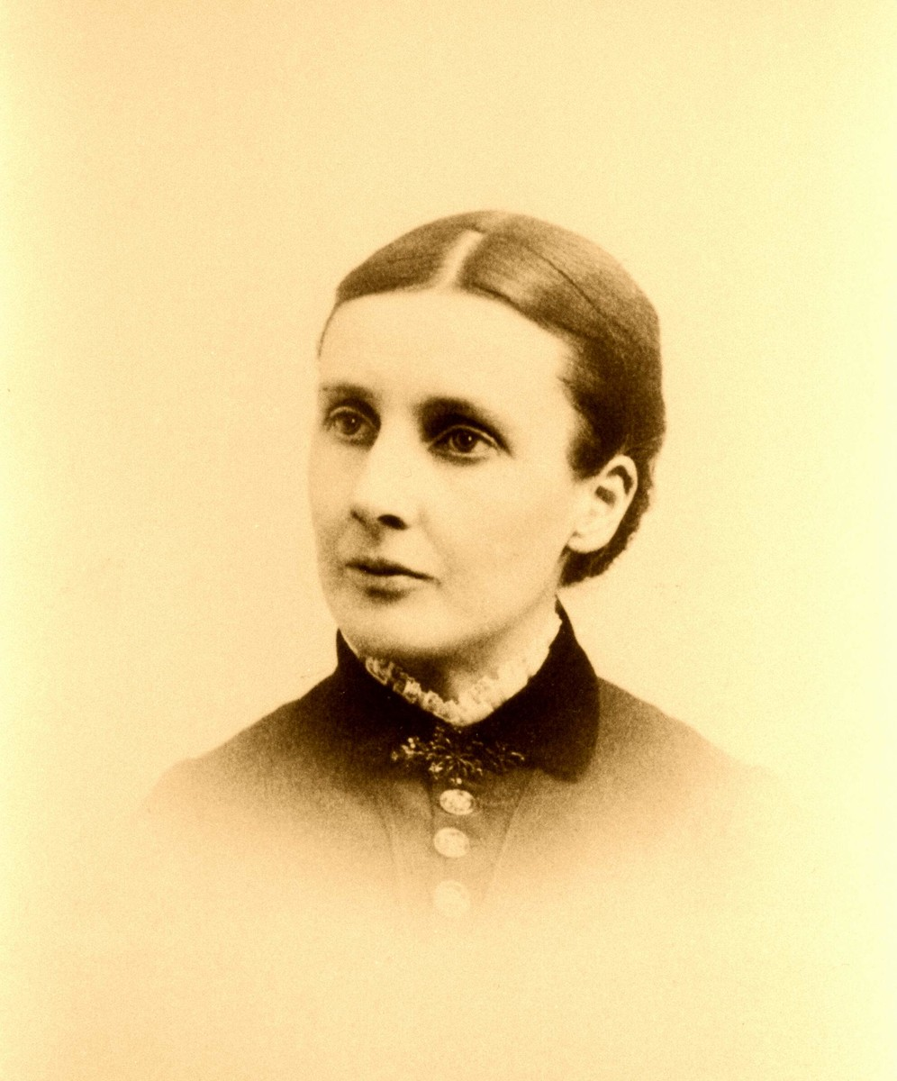
‘Parents if you wish to save your children, separate them from the world, keep them from the company of wicked children.’

Slide 13


Slide 14
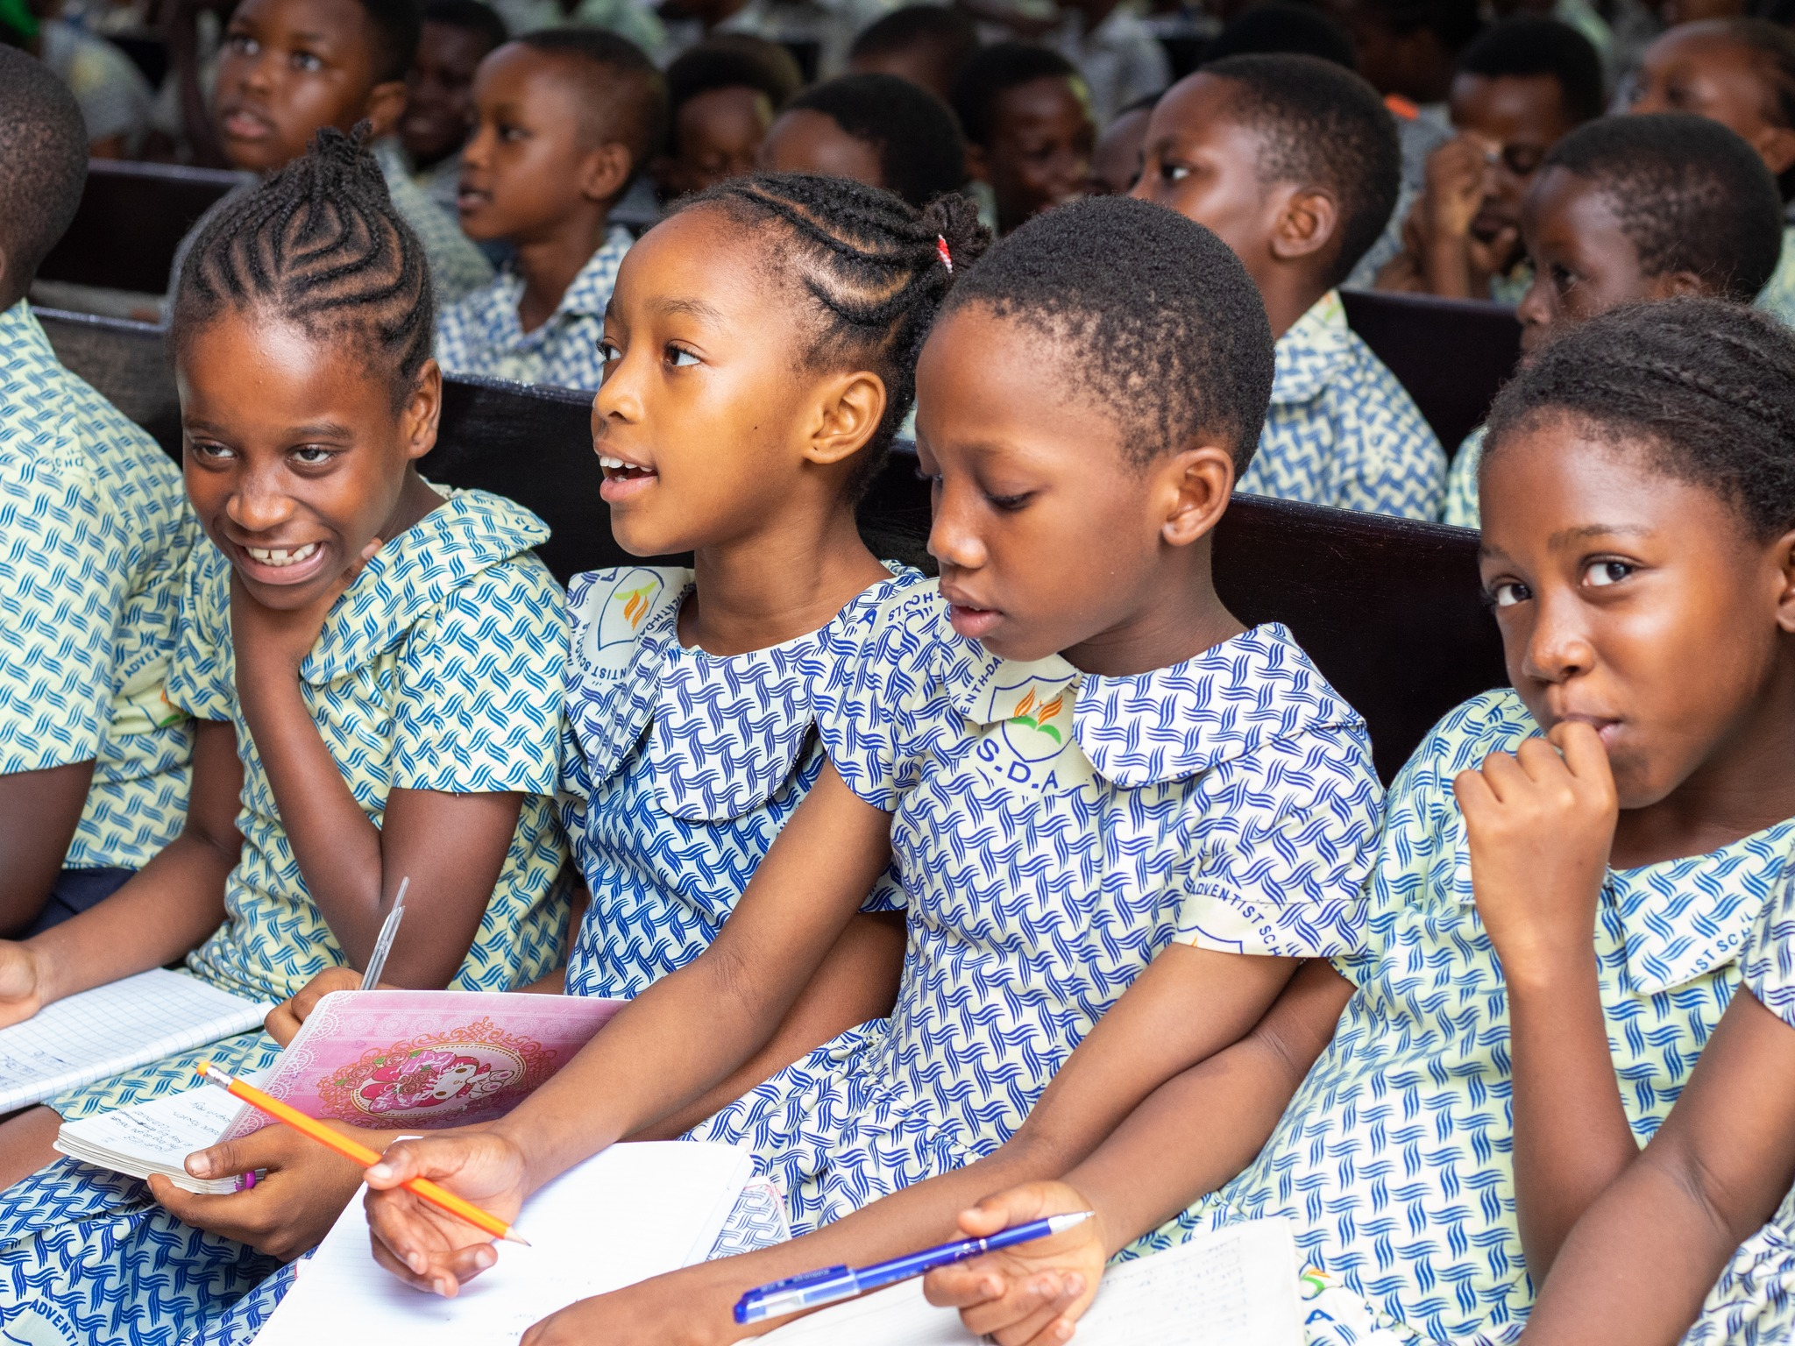
Adventist education is Christ-centred, Bible based and pointing to the aim of true education to restore human beings into the image of the Creator.

Slide 15
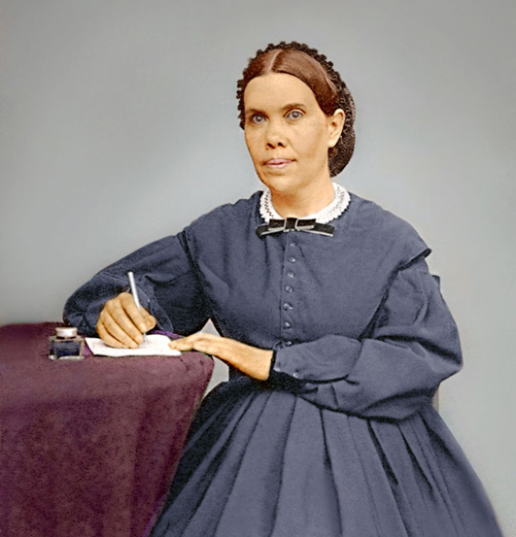
Mankind had fallen so far from the goal and standards of God that He shared that ‘the work of education and the work of redemption was one.’ (Education, EG White)
Notes:
This was God‘s opportunity to give a two pronged intervention in the lives of Adventist children – to be educated and saved for eternity.

Slide 16

An early Adventist minister recalled: ‘During the years 1853-54, the sentiment prevailed quite largely among Seventh- day Adventists that their children should be educated more directly under the supervision of those of the same faith than was possible in the public schools.

Slide 17
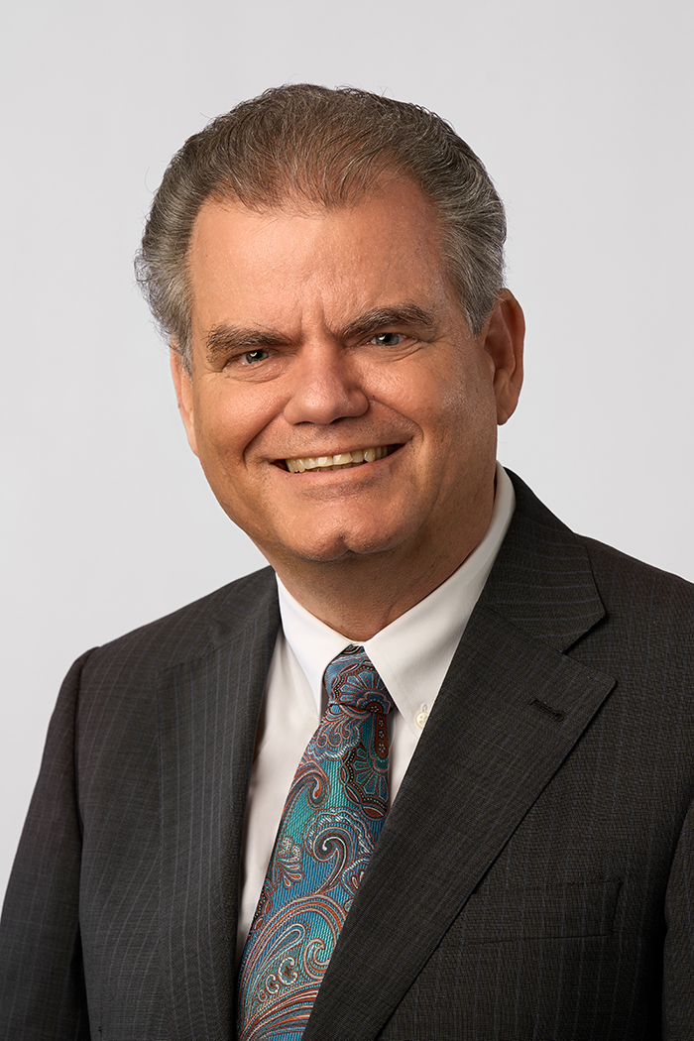
In conformity with this idea, there were many instances of home schools among our people where the children of one or more families were gathered together, a teacher procured who was firm in the faith and competent to instruct in matters of religion as well as in the common branches of school education.’
(John Wesley Taylor V, Adventist Education, Origins of)

Slide 18

Ungodly Teachers

Slide 19
‘Our ideas of education are too narrow and too low a range. There is need of a broader scope, a higher aim.
True education means more than the pursual of a certain course of study.
Notes:
We are reminded by Sis E G White to ensure that our children are not to be found sitting at the feet of ungodly teachers

Slide 20
….It means more than a preparation for the life that now is.
It has to do with the whole being, and with the whole period of existence possible to man.
It is the harmonious development of the physical, the mental, and the spiritual powers.
It prepares the student for the joy of service in this world and for the higher joy of wider service in the world to come.’

Slide 21

In our busy, rat race lifestyle we unfortunately, have lost sight of the warning God gave to His chosen people to come out of Babylon and to take our children out of the heathen schools too.
Notes:
In the merry-go-round of life, we lose the essence of the warning, it becomes watered down and not so urgent and important.

Slide 22

Expensive Private Schools

Slide 23

As we become wealthier or are placed in higher positions of authority in the church, the lowly and humble Adventist school no longer seem attractive nor appropriate for our dear and intelligent children.
Notes:
After all, we can definitely afford that expensive private school in town that all the politicians and government ministers’ children attend. This gives us clout and stature in the eyes of our brethren and makes us proud to boast of the amazing grades our children are achieving.
Unfortunately, we are taken for a ride when pulling our children out of the Adventist schools due to wealth and high standing.

Slide 24
It is the plan of the evil one for our dearest and beloved children to lose their place in Heaven by causing them to be infected by their friends who do not love the Lord and hardly ever attend church.

Slide 25

Those school friends who will encourage them to smoke, drink and visit the night clubs instead of joining the family for devotion or attending prayer meetings are tools of Satan that our children should beware and flee from their influence.

Slide 26

Conclusion
We may spend years and years riding the merry-go-round educating our children in Government schools and getting nowhere. All we may achieve will be educated, well-spoken demons who choose to follow the path of the deceiver.

Slide 27
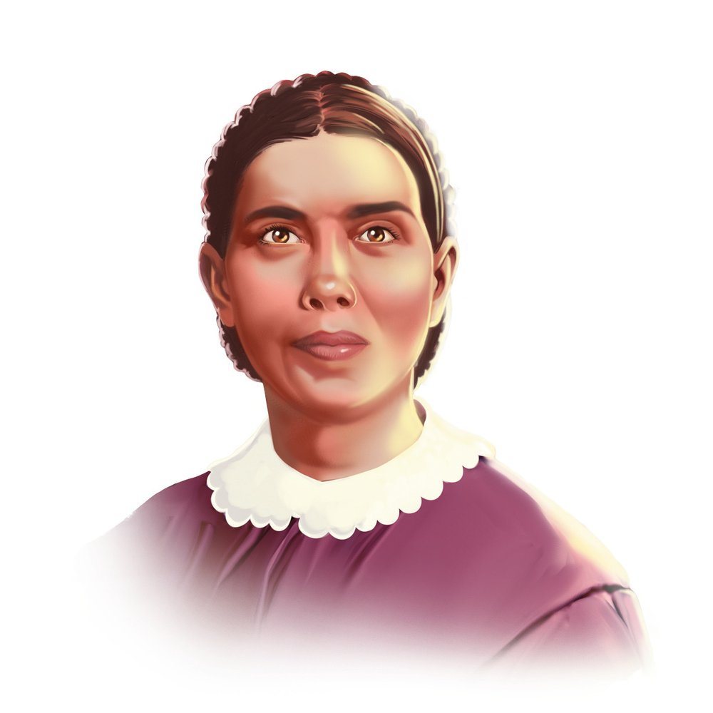
‘Instead of educated weaklings, our Adventist schools will send forth, young men and women, strong to think and to act, who are masters and not slaves of circumstances, men and women who possess breadth of mind, clearness of thought and the courage of their convictions’.
(Education – E G White)

Slide 28
‘An education that secures to the successful student his or her passport from the preparatory school of earth to the highest grade, the school above.’(Ibid.).
‘Higher than the highest human thought can reach is God‘s ideal for his children. Godliness – godlikeness – is the goal to be reached’.(Ibid.)

